Slide 1
Luminaries
Constructed from the slab technique

Slide 2
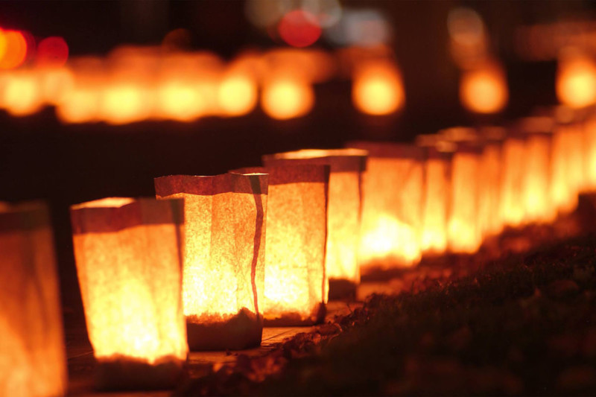
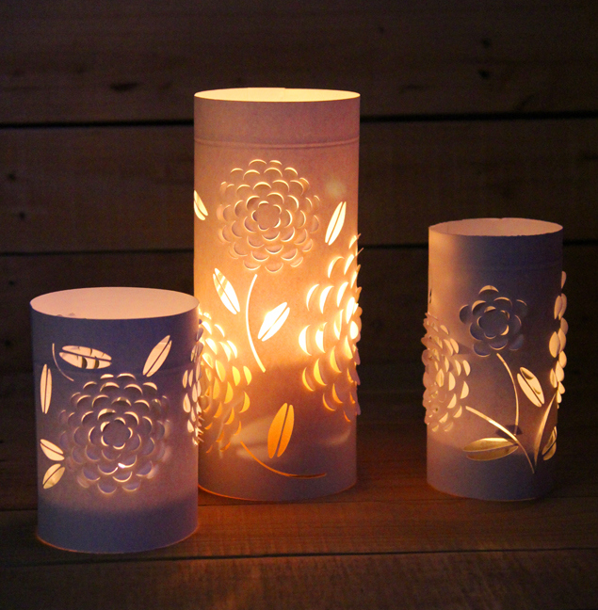
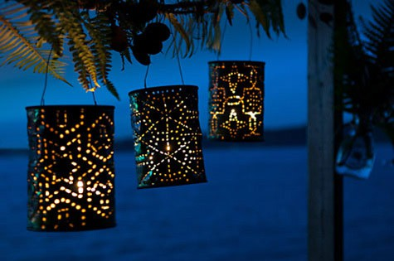
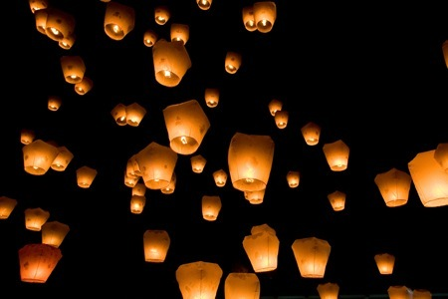

Slide 3
Origins
Lanterns are first spoken of by Theopompous (c. 380 BC – c. 315 BC) a Greek poet.
The first luminaries in North America were bonfires of crisscrossed pinon boughs arranged in 3-foot high squares.
A primitive form of candle lantern, made from white horn and wood and called a lanthorn, was first made in the time of the English King Alfred the Great(849–899CE).
Lanterns in ancient China were made of silk, paper, or animal skin with frames made of bamboo or wood. One of the earliest descriptions of paper lantern is found in records from Khotan, which describe a "mounting lantern" made of white paper.
Tradition has it that luminaria lit the way for Mary and Joseph in their search for lodging in Bethlehem.
When used in Christmas celebrations, the Roman Catholic Church believed the lights would guide the spirit of the Christ child to people’s homes.

Slide 4
Origins Continued
Other writers place the tradition back even earlier, linking it to the Jewish celebration of Hanukkah, when people mark the miracle of the container of oil that was only meant to last one day but lasted eight.
Luminaries are also linked through history to the ancient tradition of communicating, warning and celebrating through linked bonfires.
The Pueblo Indians in New Mexico have long lit small fires outside their homes to light their way to church on Christmas Eve.
In recent years, the use of luminaries has expanded so that they're used throughout the year at parties, weddings, religious ceremonies and charitable events.
The American Cancer Society’s Relay for Life events will often have luminaries placed around the walking track.

Slide 5
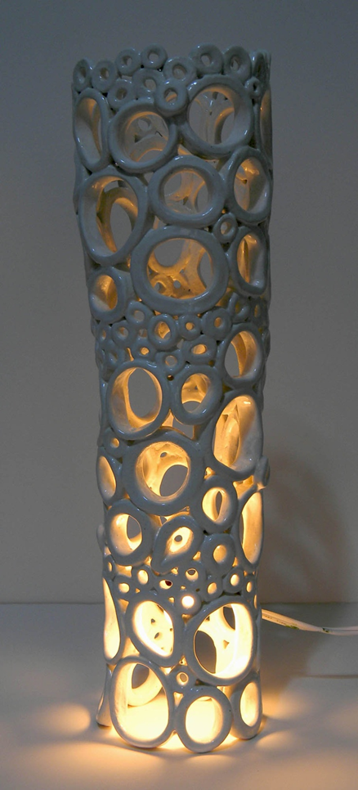
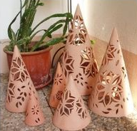
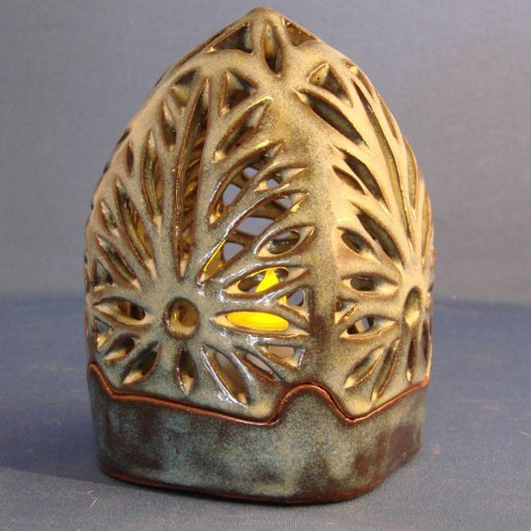
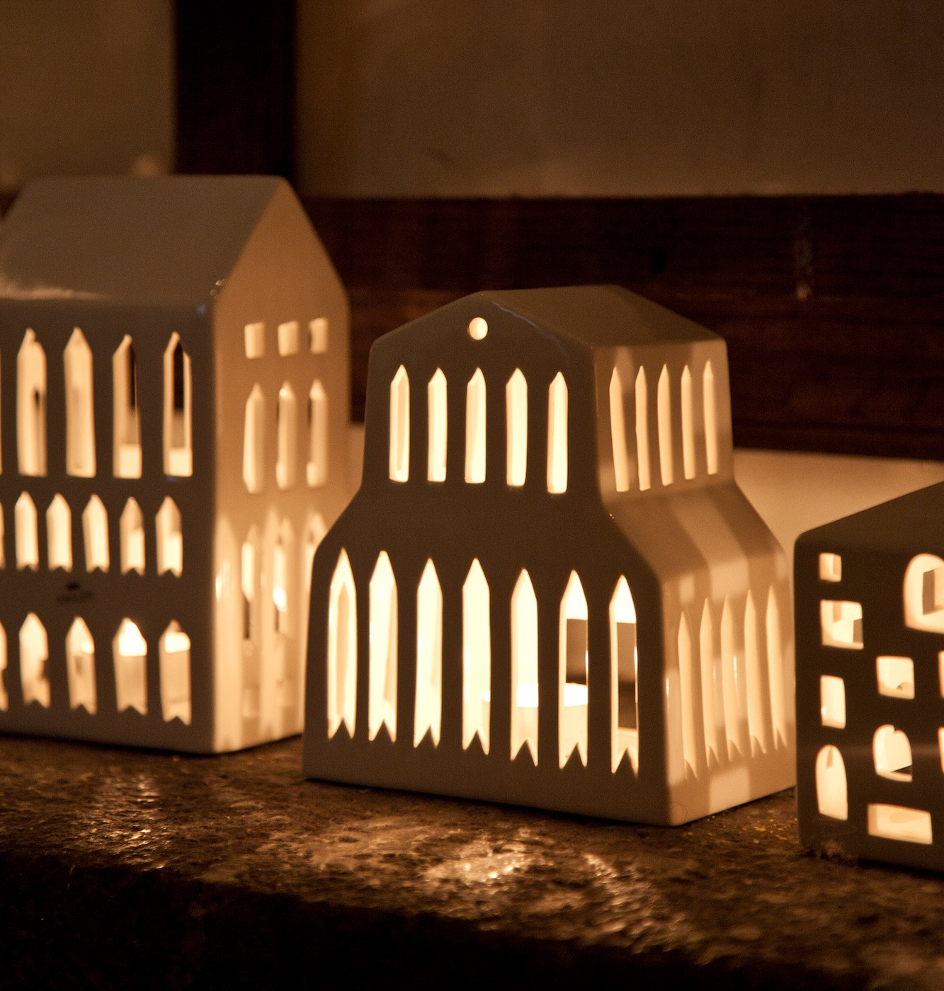
Clay Luminaries

Slide 6
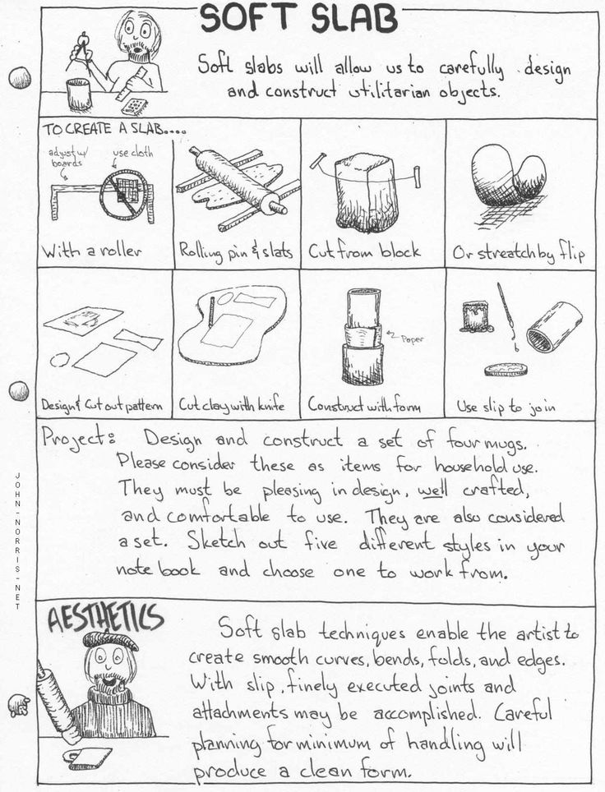
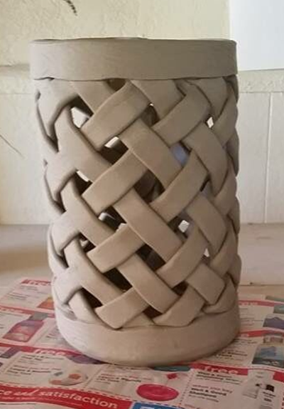

Slide 7
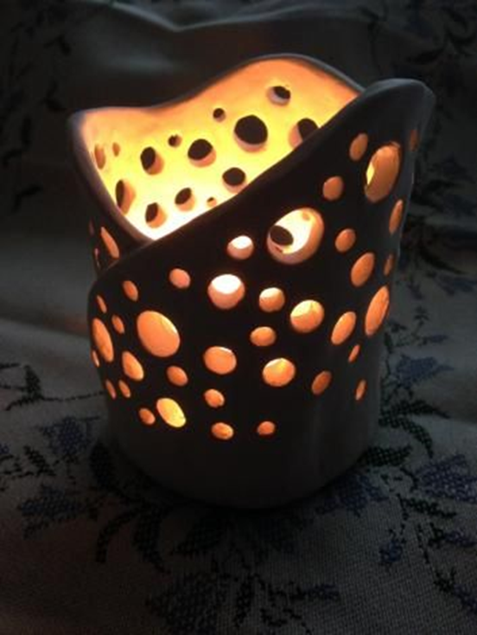

Soft Slab

Slide 8
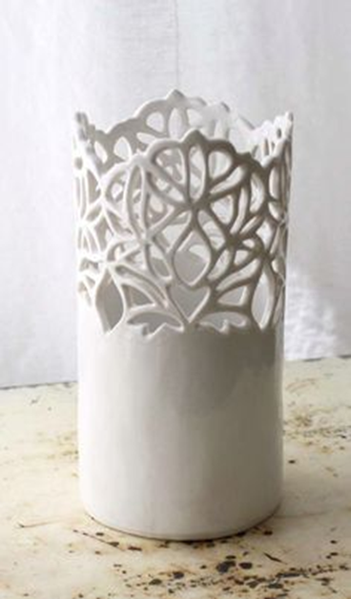
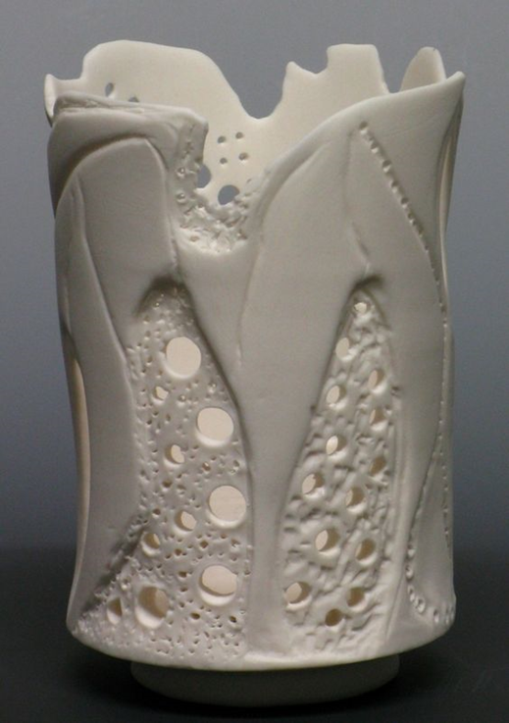
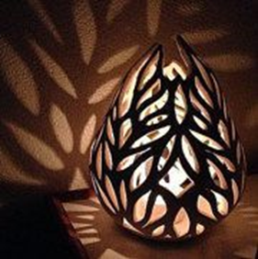
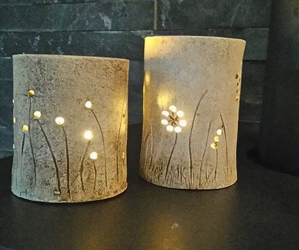
Soft Slab

Slide 9
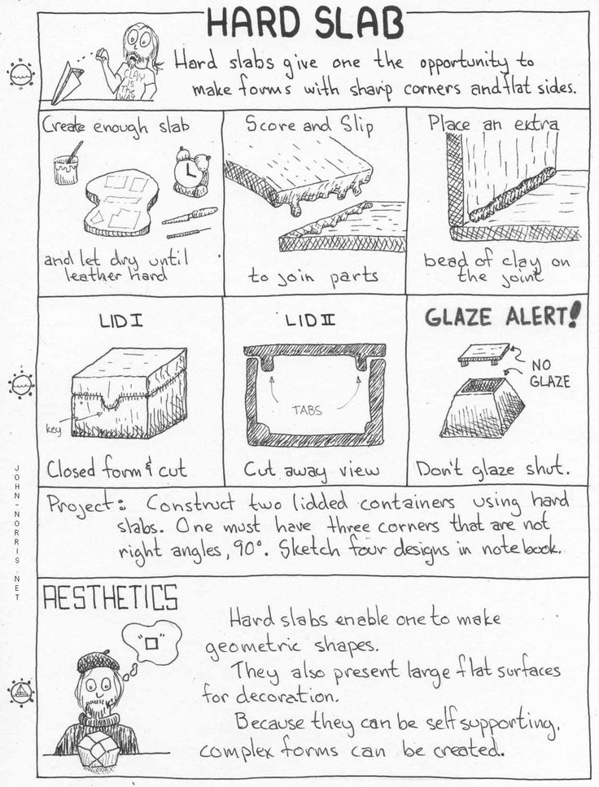
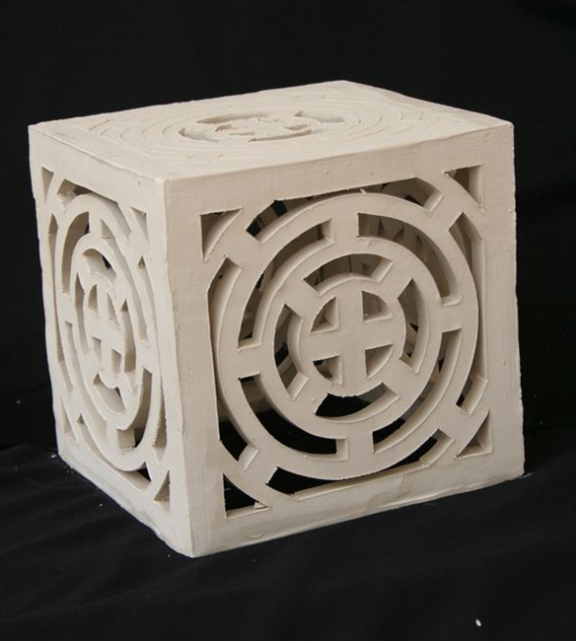

Slide 10
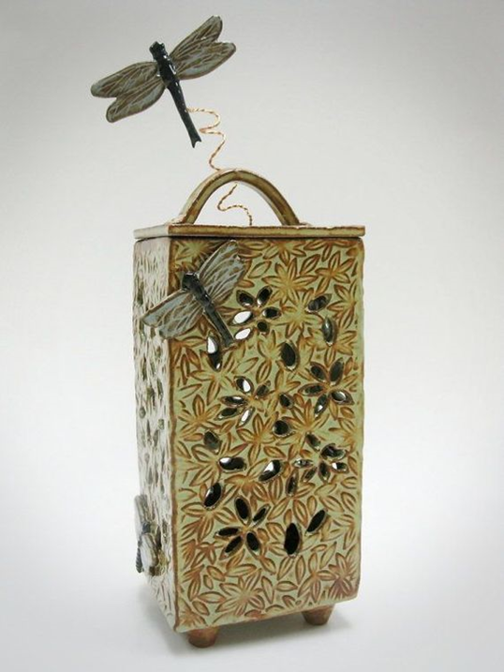
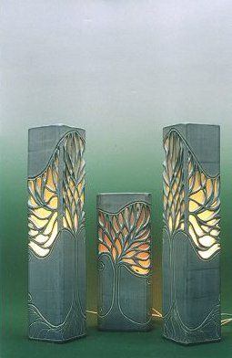
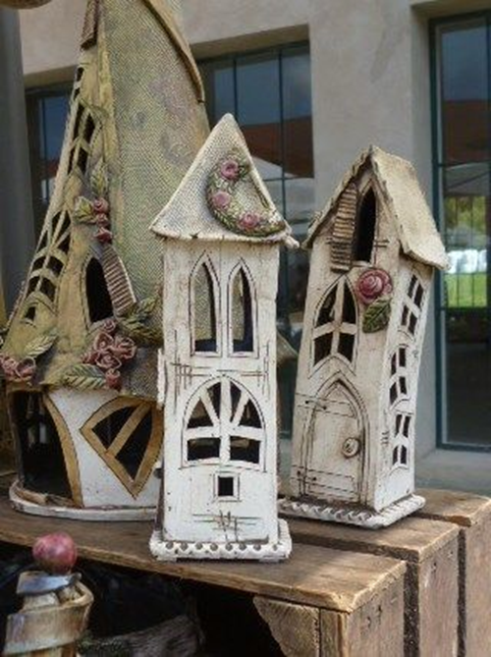
Hard Slab

Slide 11
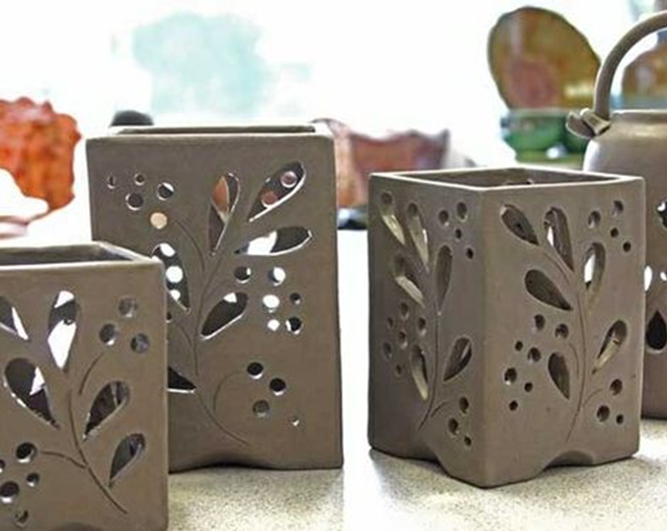
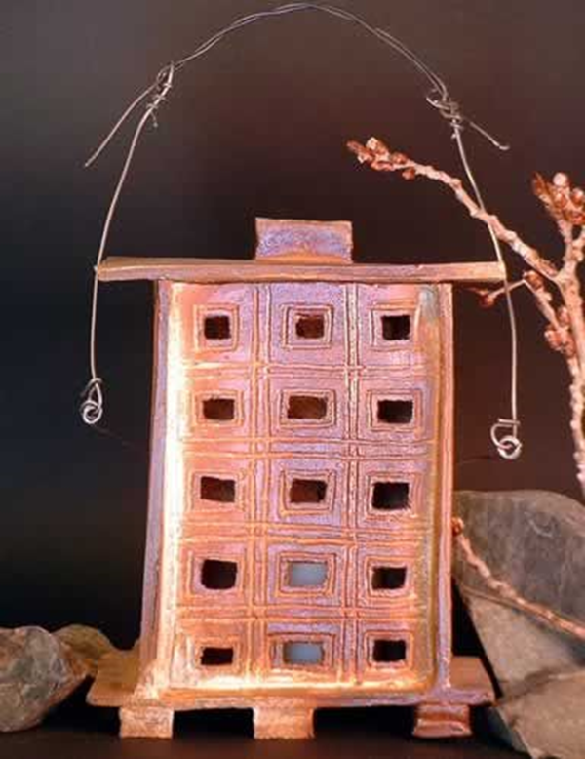
Hard Slab

Slide 12
Assignment
Create a lantern using slab construction.
  Requirements:
      Must be able to stand.
      Must illuminate light!!!!
      Height no less than 5”, no taller than 12”
      Width no less than 3”, no greater than 5”
  Things to think about:
      Will it have a lid?
      Will it have a detachable base?
      Should you use soft or hard slabs (or both)?
      How can you use pattern, shape and repetition?

Slide 13
Before you begin with clay
Make a minimum of two different slab constructed lantern sketches.
Include details in your plan about how the lantern will be cut out to illuminate light. (Think pattern, shape, repetition.)
Include your target height, width and depth.
Make a paper version of your lantern to help visualize and anticipate construction issues.
    Use a ruler for sharp edges and precision.
    Use tape to hold the pieces together.
Figure out how the lantern will be illuminated (what is your light source).

Slide 14
Things to know
Do not wedge clay “off the block” before making a slab. Reclaimed clay should be wedged and “cared for.”
Pound with hand first. Work from middle and “lower” on one side.
Slab roller or rolling pins(two directions)are both available.
Do not overly handle/bend the slabs.
Transport on rigid surface.
Clay will not stick to newsprint or canvas.
Stack slabs between pieces of newsprint for storage.
Stack slabs on top of each other for storage in the damp box. It will maximize space and help them stay flat.
Slabs need to be “babied”… make sure they dry slowly to prevent warping.

